Slide 1

AI-POWERD STUDY BUDDY
An Intelligent Learning Assistant for Students
Presented By : Amrutha k
course name : AI/ML Internship project-Edunet Foundation
college name : Government college mokeri
Department : Bsc Mathematics

Slide 2

OUTLINE
02
INTRODUCTION
PROBLEM STATEMENT
EXISTING SYSTEM
LIMITATIONS OF EXISTING SYSTEM
OBJECTIVE OF THE PROPOSED SYSTEM
FEATURES OF AI POWERED STUDY BUDDY

Slide 3

03
INTRODUCTION
Education is rapidly transforming with the support of AI technologies, which gently assist students in understanding complex topics more effectively while reducing the time required by traditional learning methods through personalized and simplified learning experiences.

Slide 4

PROBLEM STATEMENT
04
Students often struggle with complex topics and find online information confusing or irrelevant. Teachers are not always available for immediate help, and personalized learning support is limited. This highlights the need for a simple, student-friendly intelligent learning assistant.

Slide 5
EXISTING SYSTEM
05
Students rely on textbooks, lecture notes, and online platforms like Google and YouTube for learning. However, these sources offer limited personalization, require time to filter useful content, and do not provide instant assessment or feedback.

Slide 6

LIMITATIONS OF EXISTING SYSTEM
06
Information overload with difficult language and explanations
No adaptive or personalized learning support
Manual effort required for note summarization
No instant quiz or flashcard generation

Slide 7
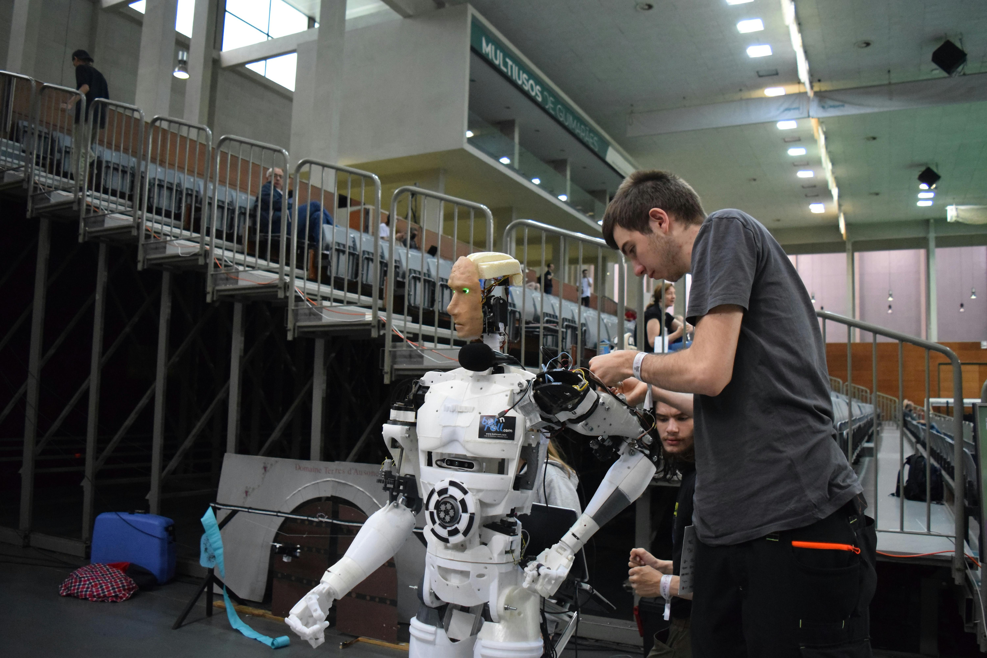
PROPOSED SYSTEM
07
01
AI-based learning assistant
The following is the implementation process that must be carried out:
02
Simple explanations
Quick summaries
03
Instant quizzes and flashcar
04
24/7 availability
05

Slide 8

OBJECTIVES OF THE PROPOSED SYSTEM
08
The system simplifies complex academic topics, saves students’ study time, improves understanding and retention, provides interactive learning tools, and supports self-paced learning.

Slide 9
FEATURES OF AI-POWERED STUDY BUDDY
Concept explanation in simple terms
Smart note summarization
Automatic quiz generation
Flashcard creation for revision
User-friendly interface
09

Slide 10

KEY FEATURES
10
Concept explanation in simple language. Automatic note summarization. Quiz and flashcard generation for revision. User-friendly interface on web and mobile.

Slide 11
11
SYSTEM ARCHITECTURE
User Interface: Web or mobile app for interaction.
AI Processing Module: Handles content analysis and learning.
NLP Module: Understands and processes student queries.
Database: Stores notes, quizzes, and learning material.
Output Module: Provides results, feedback, and suggestions.

Slide 12
12
RESULTS
Faster understanding of complex topics. Higher engagement with learning material. Better performance in quizzes and exams. Enhanced confidence and independent learning

Slide 13
13
CONCLUSION
AI study buddy supports modern learning needs. Makes education more interactive and accessible. Helps students save time and retain information better. Promotes self-paced and efficient learning.

Slide 14
14
REFERENCES
Streamist Community Cloud – Streamist Docs
Google AI Studio
Python Official Website: https://www.python.org/
Hugging Face – The AI community building the future

